Slide 1


Aavishkar
Inter-Collegiate/Institute/Department Research Convention
Level: UG
Category: Engg. & Tech
Slot No.:
IOT BASED
SMART HYBRID SOLAR TREE WITH MONITORING USING GREEN ENERGY
T -> Tree generation
R -> Renewable
E -> Energy &
E -> Efficiency

Slide 2


INDEX
Introduction
Objectives
Need of Solar Hybrid Tree
Research Methodology
Implementation of system
Result & Analysis
Advantages, Drawbacks, Features
& Applications
Future Enhancement
Conclusion
References

Slide 3

INTRODUCTION
India is blessed with an abundance of sun radiation, which draws the development of numerous solar photovoltaic power plants.
The continuous demand-supply imbalance in the electricity sector can be effectively addressed with the help of renewable energy sources.
In the same way that green leaves produce food for living things, they also generate energy for society. So, it is extremely reasonable to designate it as tree.
The hybrid solar tree is built to guarantee that each solar panel receives the most sunshine possible while casting the fewest shadows possible on any other panels. This guarantees that the solar tree will produce the most electricity feasible.
Utilizing green/renewable energy has both environmental and financial advantages, such as producing energy without the use of fossil fuels and reducing some forms of air pollution. increasing energy supply diversity and decreasing reliance on imported fuels.

Slide 4

To fulfill the growing Energy demands using Renewable Energy Source of Solar Rays
1
To use Renewable Energy by Different Applications
2
OBJECTIVES
3
To reduce Pollution from Power Plants
4
To convert the Sun rays into Electrical Energy
5
To develop the Rural/Remote Areas

Slide 5

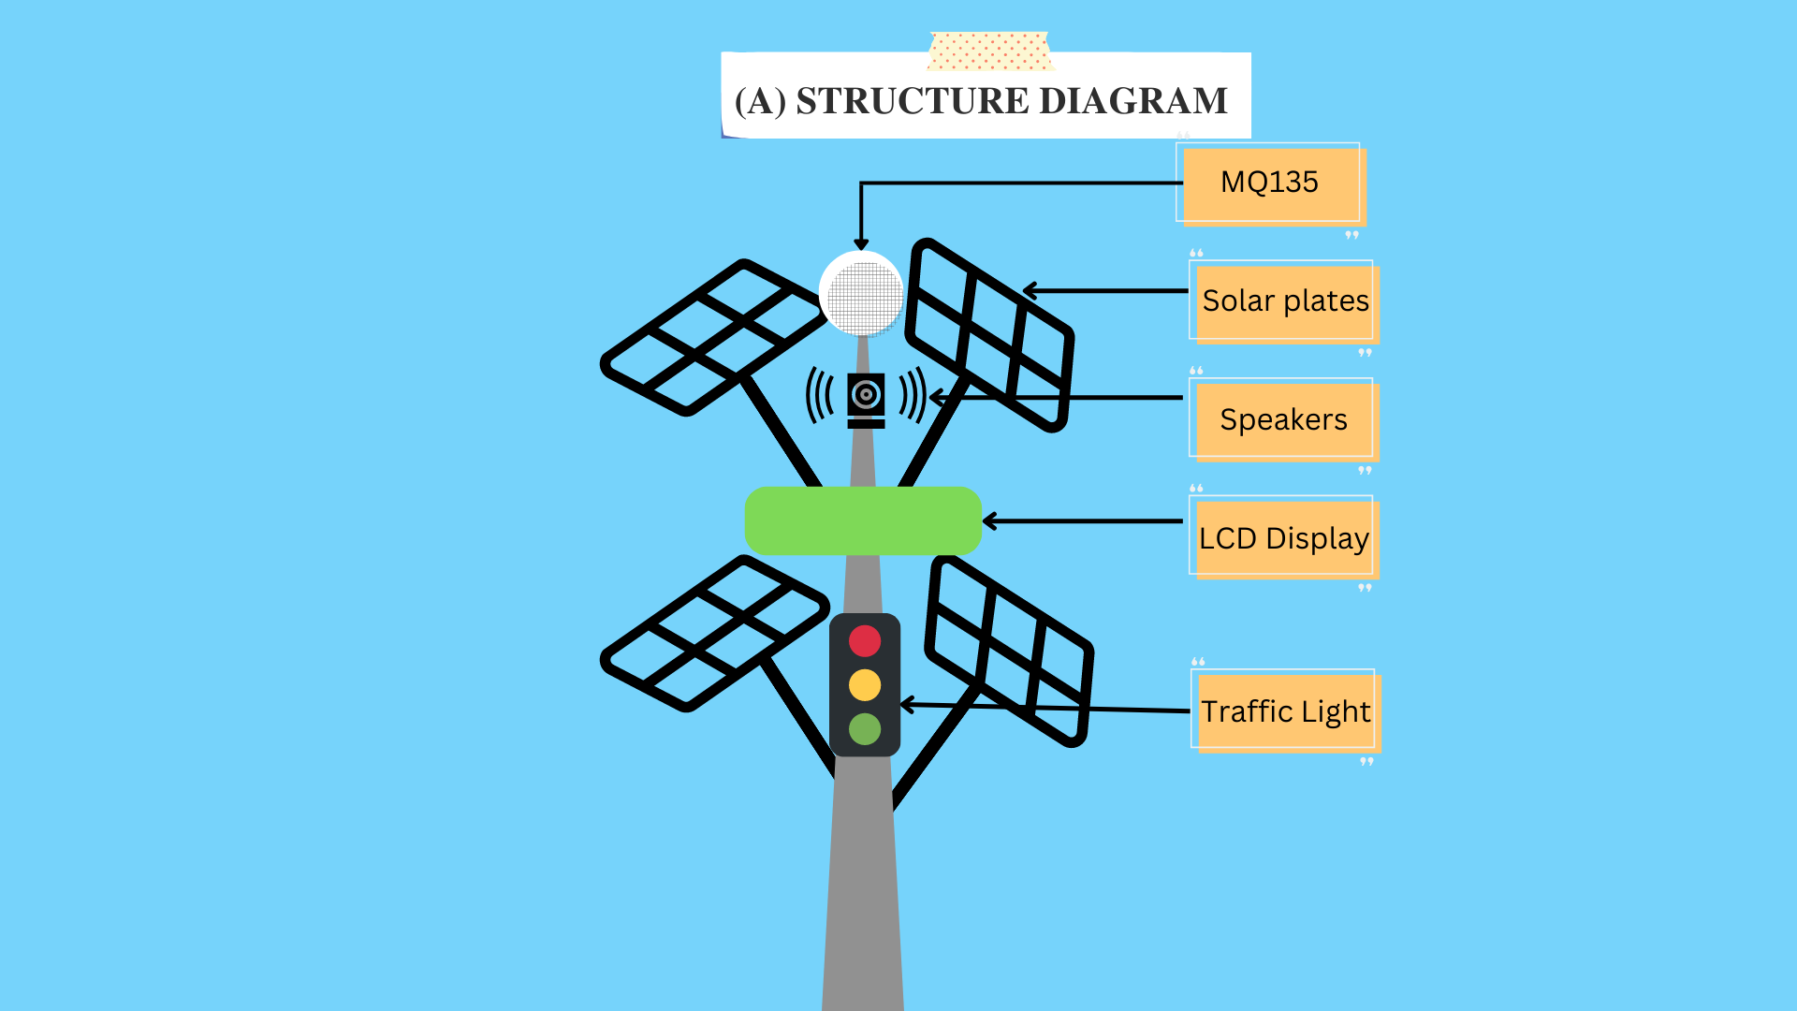
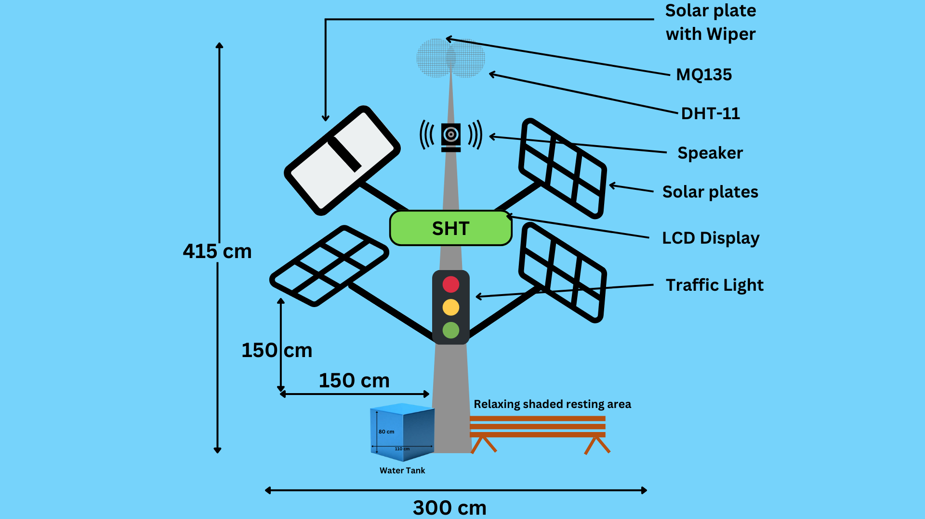
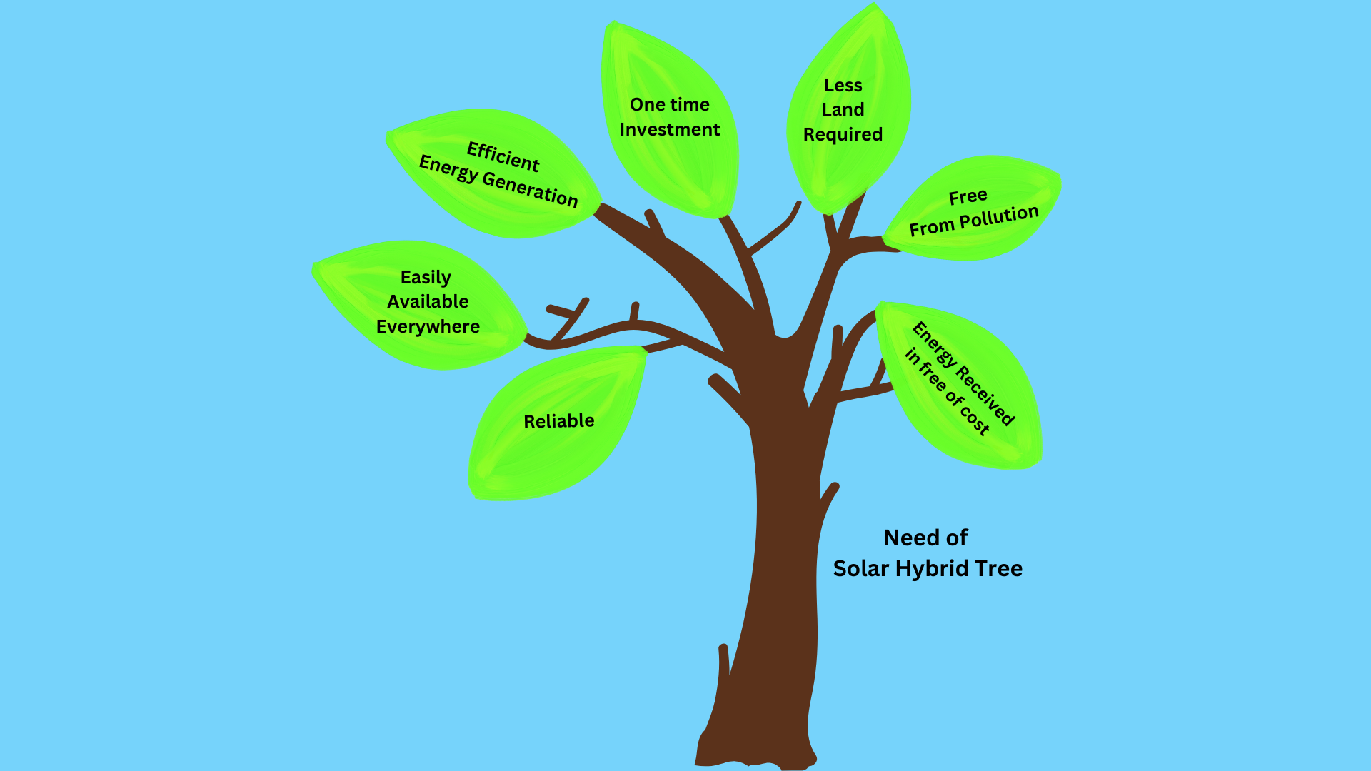
NEED OF SHT
Fig 1: Need of SHT
Fig 2: Structure Diagram of SHT

Slide 6

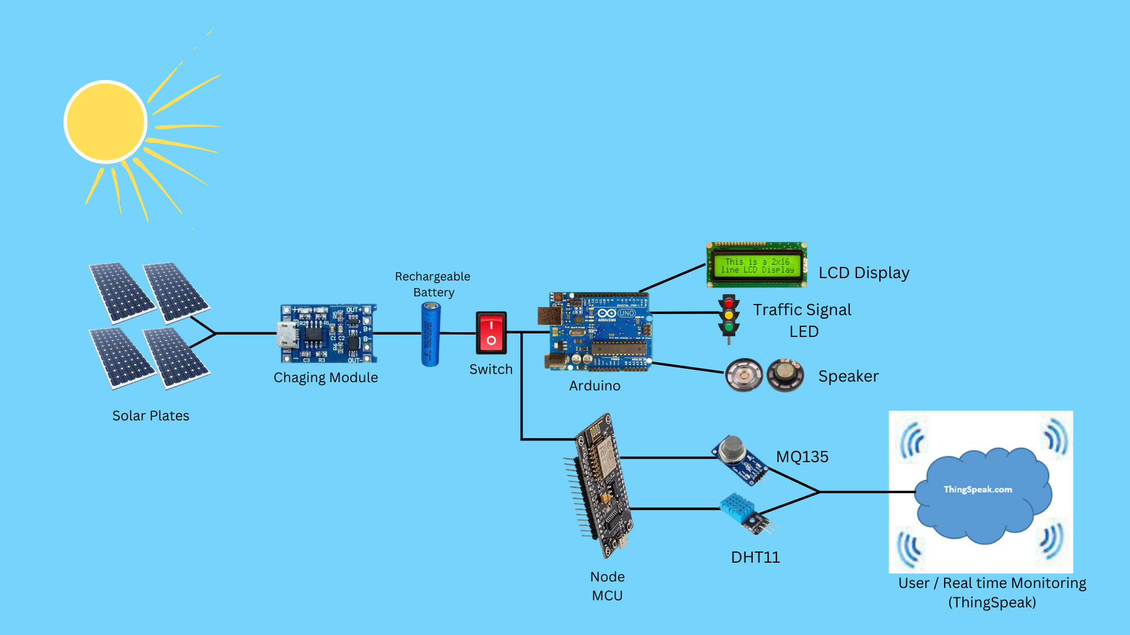
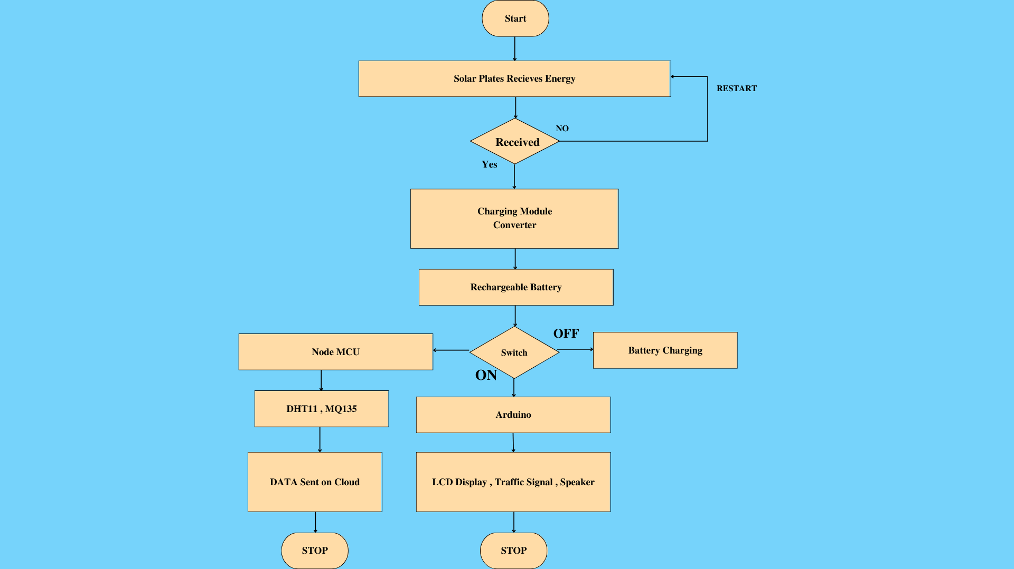

Research Methodology
Fig 3: System Diagram of SHT
Fig 4: Flow Diagram of SHT

Slide 7


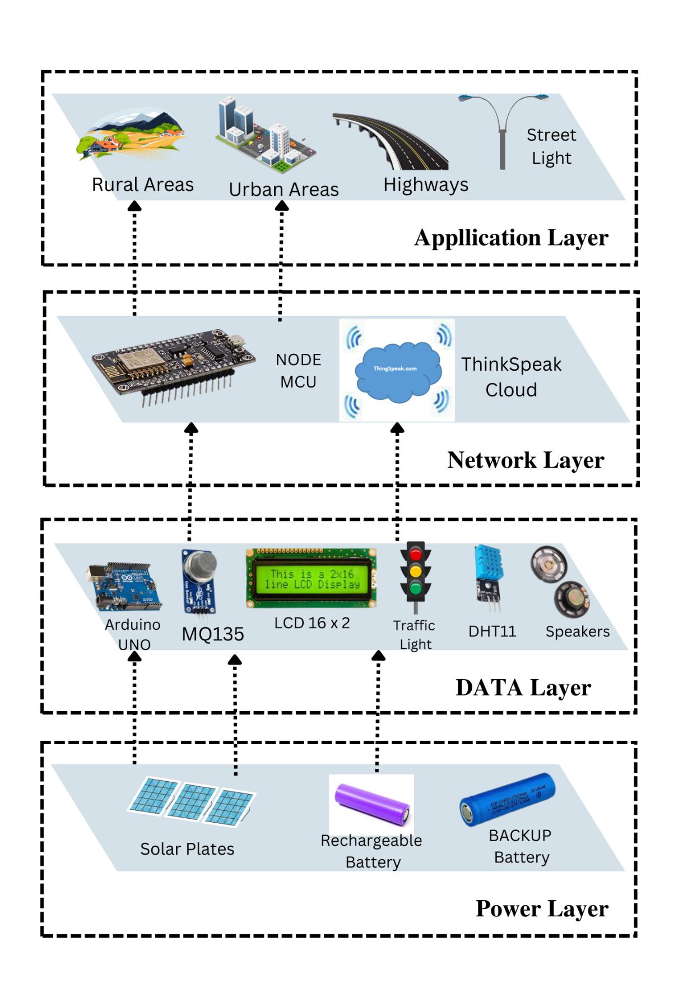
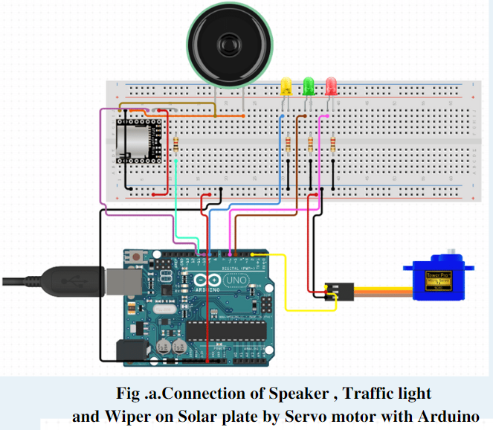
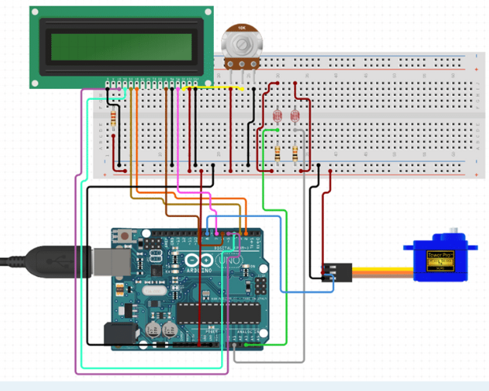

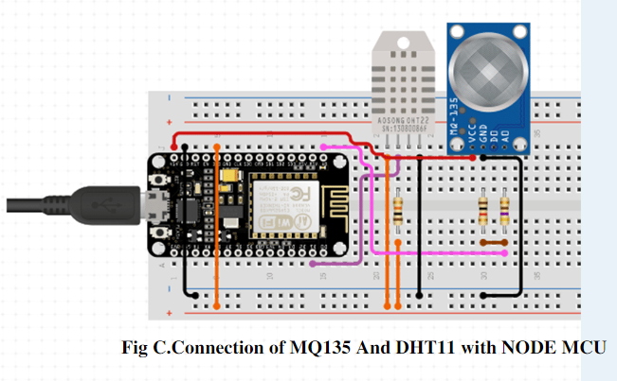
Fig 5: Architecture Diagram of SHT
Fig 6: Circuit Diagram of SHT

Slide 8
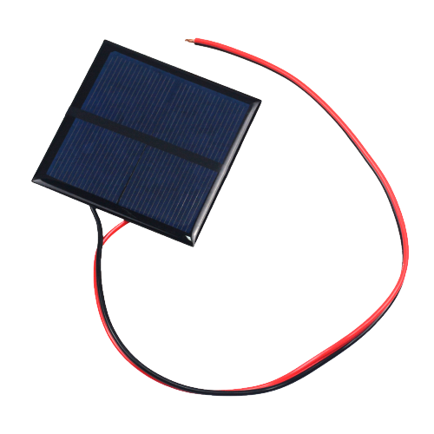
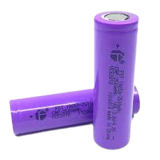
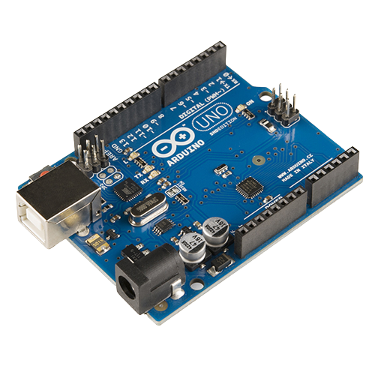
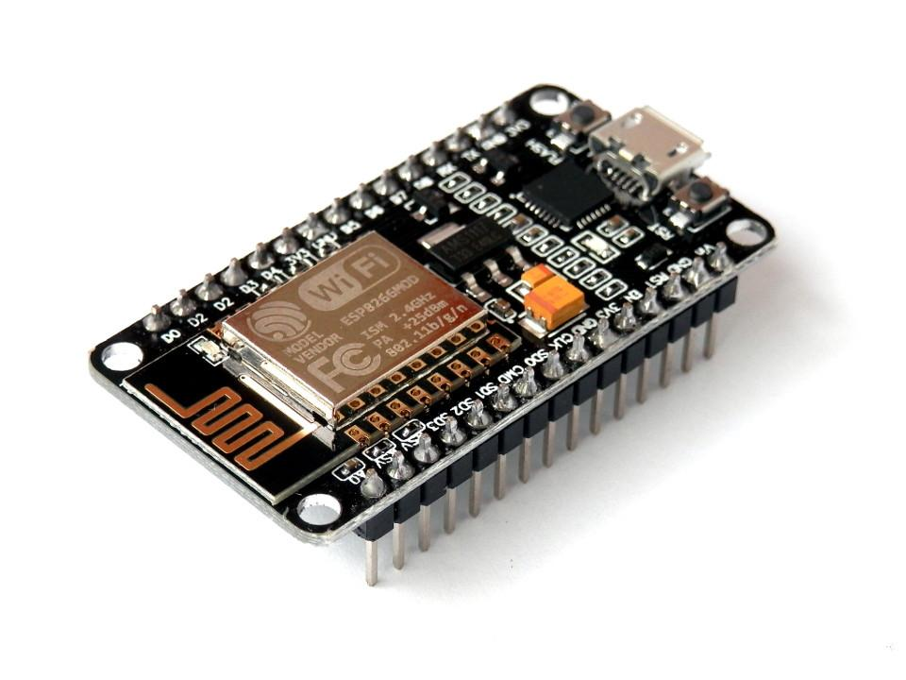
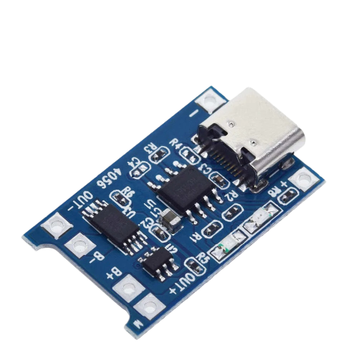

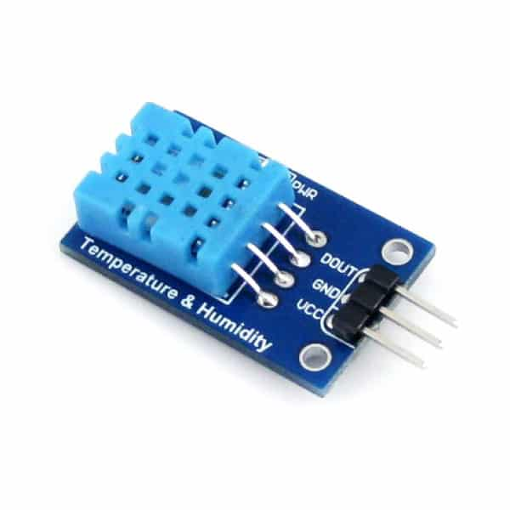
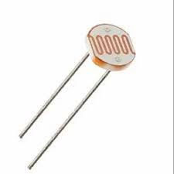
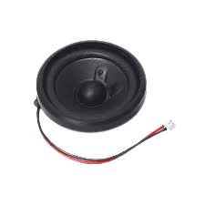

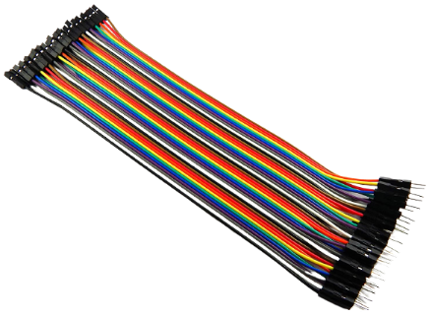
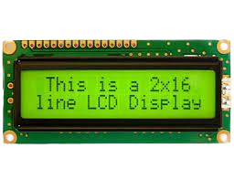
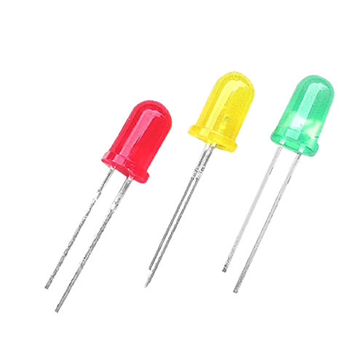

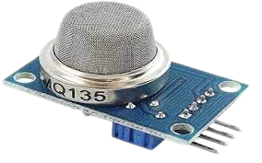

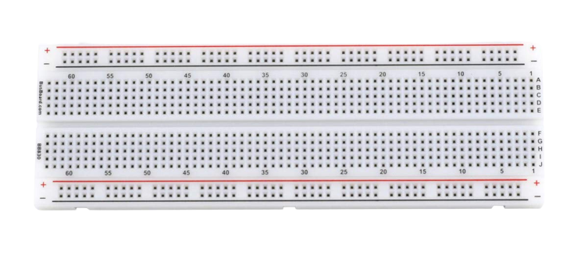
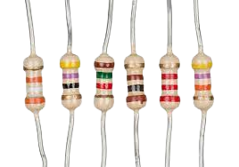
COMPONENTS USED
Solar Panels
(6v,100mA)
NODE - MCU
Rechargeable Batteries
(Li-ion 2500mAh)
Battery Charging Module
(TP4056)
Arduino UNO
Servo Motor
Air Quality Sensor(MQ135)
LCD Display(16x2)
DHT-11
Temperature Sensor
Speaker
(3 watt, 8ohm)
LED (RYG)
Resistors, Potentiometer, Jumper Wires, Breadboard, Diode, Switch, LDR
Fig 7: Components of SHT

Slide 9

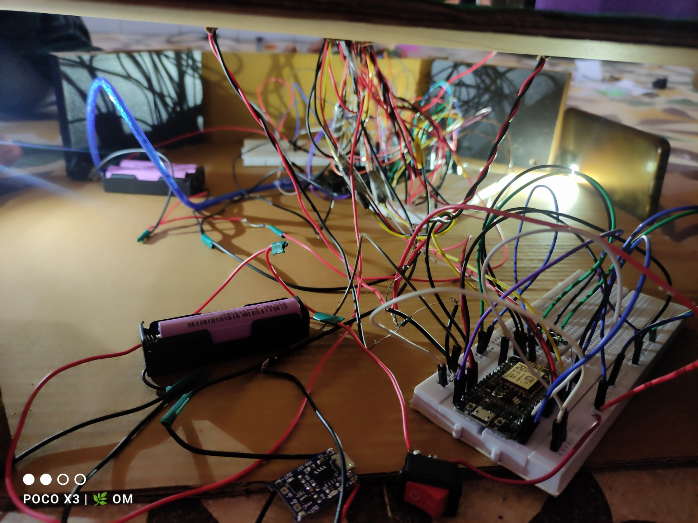
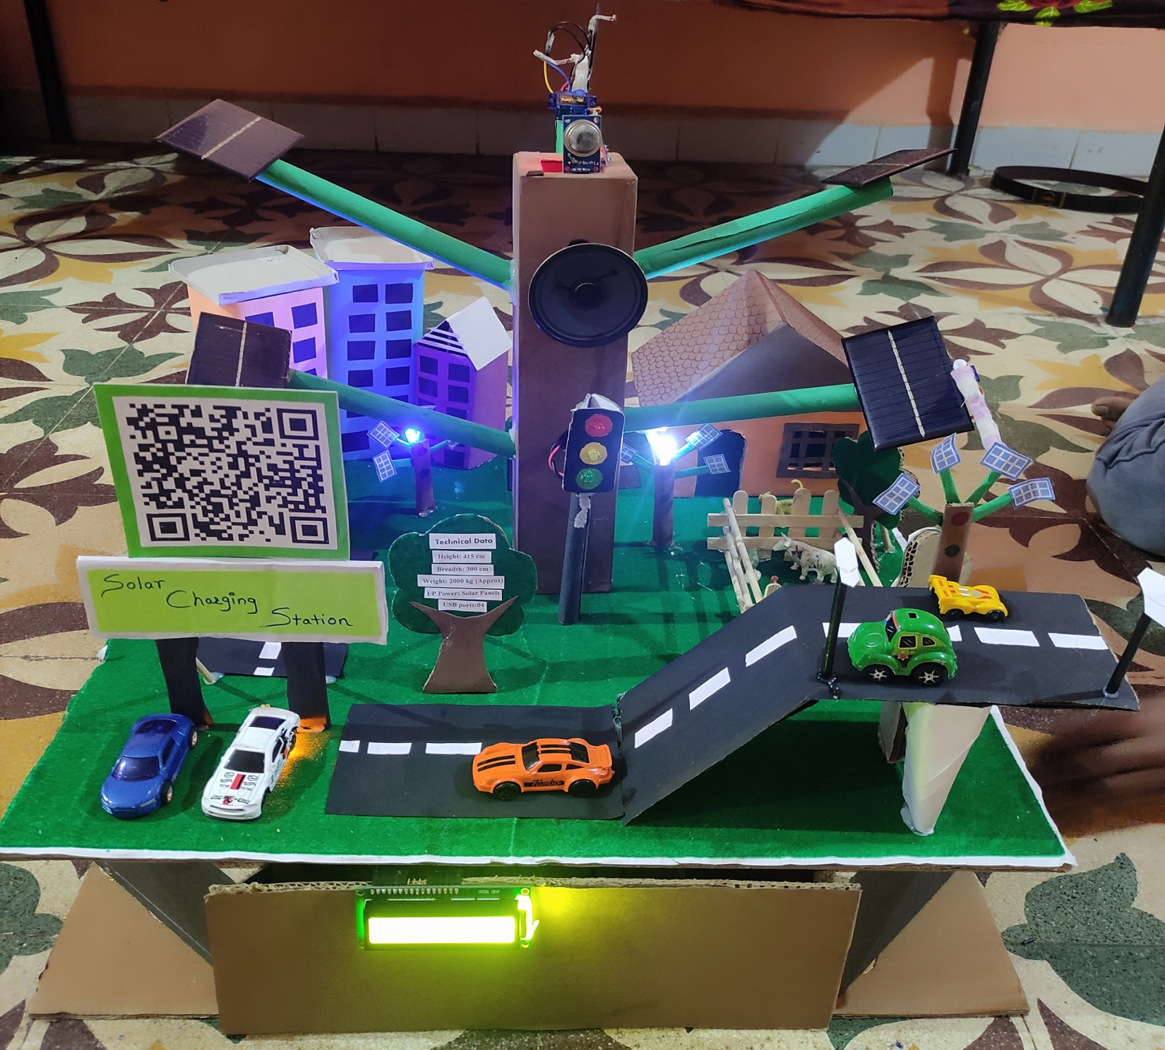
Result & Analysis
ACTUAL CIRCUIT
Final View
Fig 8: Actual Circuit of SHT
Fig 9: Final View of SHT

Slide 10
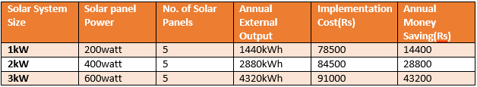
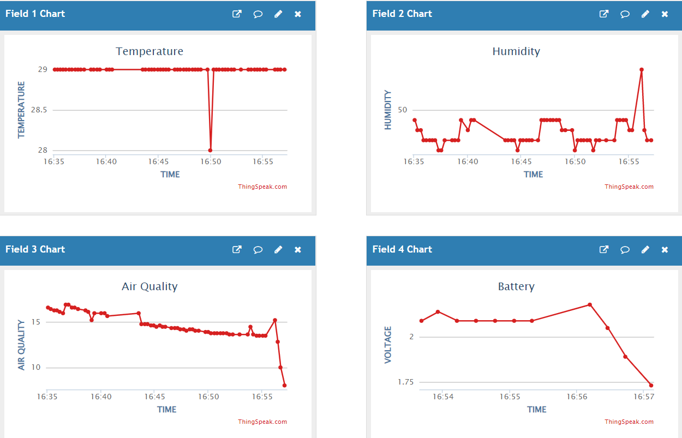
Result & Analysis
Power Consumption of
Solar Plates
Fig 10 : Real time monitoring of Sensors Data

Slide 11






ADVANTAGES
DRAWBACKS
Multiple Operation management in Efficient way
Associated Price
More eco-friendly & easily available power source
May harmful for birds and Insects.
Better use of renewable energy through IOT
Due solar reflections, it may affect eyesight.
Unlimited power supply
It depends on the power supply
Real Time Monitoring using Thing-Speak
APPLICATIONS
FEATURES
Charging Stations
More eco-friendly & easily available power source
Electrification of rural villages, remote areas, farm houses, etc.
Easy to operate, Maintenance & Servicing
Mega street Highways,Street lights & Traffic Signals
Pollution free, Reliable & no recurring fuel cost
Urban areas, hospitals, Atm Machines, Vending Machines Plazas,schools,railway stations, etc.
Dynamic design with Sensor version.

Slide 12
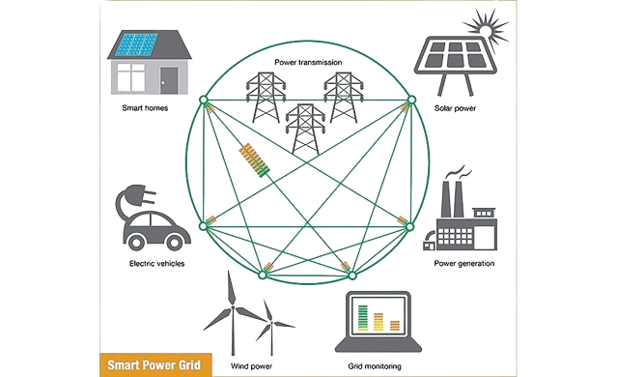
Future Enhancement
Back-up Batteries
Monitoring of power consumption by Solar Hybrid Tree
Weather Forecasting using Sensors
Alert messages to government offices
using GSM module
Maintaining the records of vehicles using Camera (e.g. : Toll Plaza)

Slide 13
Conclusion
Increased use of renewable energy will help maintain a sustainable environment.
In this research, many remote areas, streets, societies, plazas, hospitals, and schools can be lighted.
Easily locating highly polluted areas
It will also satisfy the increasing demand for electricity with hybrid solar trees.
Power can be supplied to villages located far from the construction sites of large power generation plants such as hydroelectric and nuclear plants.

Slide 14
References
[1] Sujit Patil, RavindraNangare, Rajesh Mane, Suraj Jadhav, Nilesh Patil, DhananjayGavali, “oxygen, hydrogen and light generation using solar tree”, International Journal of Industrial Electronics and Electrical Engineering, ISSN: 2347-6982 Volume-5, Issue-3, Mar.-2017.
[2] Jeng-Nan Juang and R. Radharamanan, “Design of a Solar Tracking System forRenewable Energy”, Proceedings of 2014 Zone 1 Conference of the American Society for Engineering Education (ASEE Zone 1),2014.
[3] KalhanKampasi, Suhas D. Shete, “pic-controlled oxygen and light generation using renewable resources” International Journal of Technical Research and Applications, e-ISSN: 2320-8163, Volume 3, Issue 5, PP. 198-203, (September-October, 2015).

Slide 15

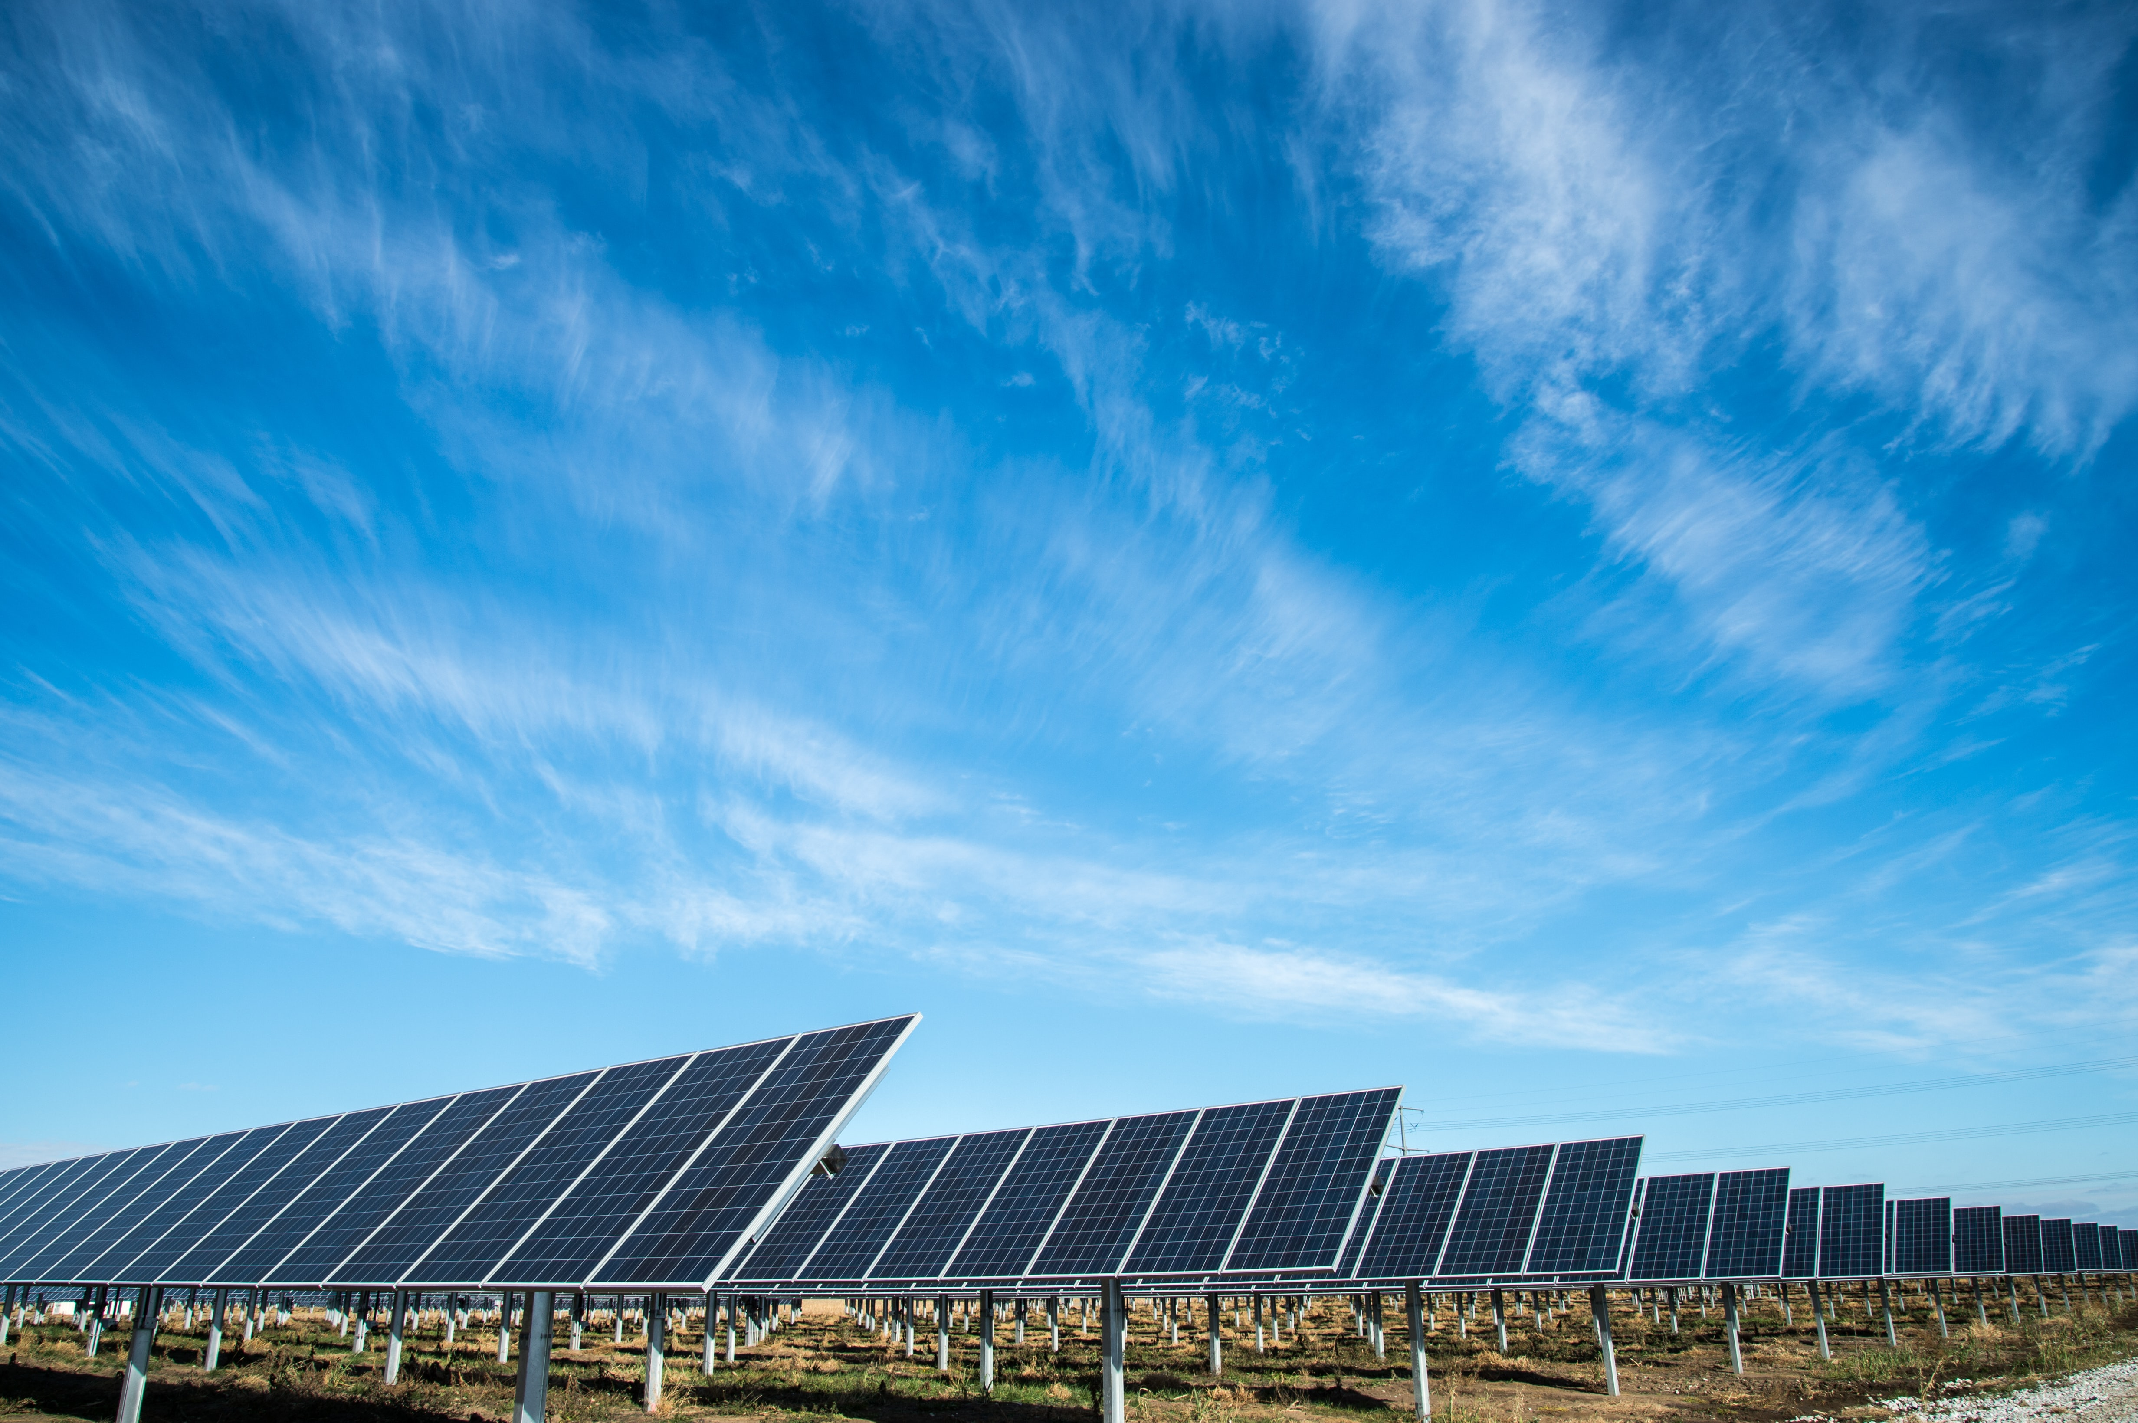

THANK
YOU!
Have a
Great day ahead.

